Slide 1
Collocations in context
A new perspective in collocation networks

Slide 2
What is the focus of the context?
In the context we focus on:
The communication of meaning
The connections between words, not the single word
The repeated patterns, not one-off occurrences
Both quantitative and qualitative exploration

Slide 3
The context is:
A network of meanings ( Linguistic, social, scientific, religious and so on)

Slide 4
Collocation in context: basic principles
The text in a particular field of discourse is organized into lexical patterns which can be visualized as networks of words that collocate with each other.
This idea was explored in a number of studies using both general and specialized corpora.
These studies indicate that collocation networks have the ability to provide us with an insight into important lexical connections in discourse.

Slide 5
Collocation in context: basic principles
These connections can be analyzed on a systematic bases with appropriate computational system

Slide 6
Association measures and collocations parameters notion:
A collocation is the frequent co-occurrence of one word with another, so it is one way to learn about the relationship that one word has with other words in specific corpora.
The collocation networks can be used to operationalize the psychological notion of the aboutness of the text.

Slide 7
Association measures and collocations parameters notion:
Therefore, collocations are a way of getting deeper insight into what the text is about.
The collocation relationship is a complex one.

Slide 8
GraphColl

Slide 9
GraphColl
GraphColl is a tool for building and exploring networks of linguistic collocations.
It is a free tool which provide full control over the statistics and methods used to build collocation network.

Slide 10
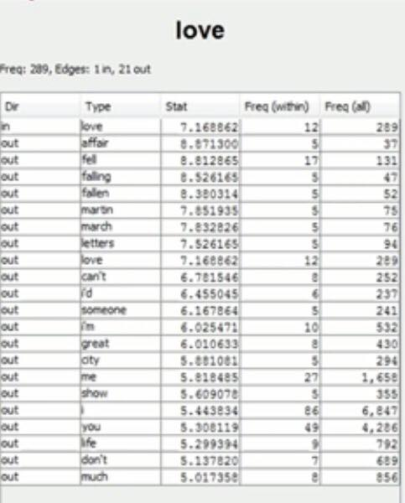
Graphcoll
Usually when we look at collocations in other tools, we have this table view that tells us which collocates, in this case, the collocates of the word love are statistically important for the word love.

Slide 11
Graphcoll
Here we have collocate such as affair, fall, falling, fallen, love letters, and so on.
We also have statistical measures, in this case, it is the MI score, the mutual information that can be used to highlight the most important collocates.

Slide 12
Graphcoll
Graphcoll presents another insight into this collocation relationships by showing collocates in a graphical way.

Slide 13
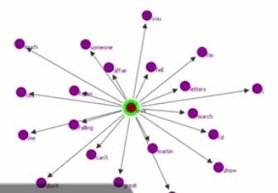
Graphcoll
This is an output from Graphcoll. Actually, Graphcoll allows you to switch between the table view and graphical view and compare between them very easily and switch from one to another

Slide 14
GraphColl
In the graphical view, we can see what we call the node, the words that we are interested in, love in the middle, and different collocates around the word love with different distances. The closer the collocate is to node, the stronger the relationship between the word love and the particular collocate.

Slide 15
GraphColl
So, you can see, for instance, affair, and fell are fairly close to the centre of that node which is the word love.

Slide 16
GraphColl
With GraphColl, we can move easily beyond the first-order collocates to explore relationships between collocates at various levels of the collocational relationship

Slide 17
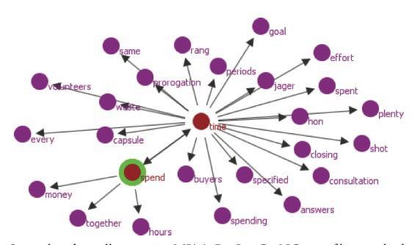
GraphColl
This figure displays second order collocates around the node spend which is one of the prominent collocates of the original node time. We can see that, apart from time, spend is connected with another temporal expression( hours), the adverb( togather) as well as the noun ( money ).

Slide 18
GraphColl
The connection between time and money is well-established in the literature on conceptual metaphors. GraphColl provides empirical evidence about the connectedness of these two concepts based on a corpus of general English which show that this connection is the most strongly established through various forms of the verb spend.

Slide 19
GraphColl
We can observe that both time and money also have a number of unique associations that create a complex network of meanings that surpasses that one-to-one mapping “ time is money” originally suggested by Lakoff and Johnson.

Slide 20
GraphColl
When we think of collocation theoretically, there are several criteria that we use to identify collocations or different aspects of the collocation relationship. People have looked at different criteria which are distance, frequency, exclusivity, and dispersion.

Slide 21
Distance
By distance, we mean that span on the left and on the right when we are looking for the collocates around the node.

Slide 22
Frequency
Frequency, of course, is the frequency of the co-occurrence of the words that we are interested in.

Slide 23
Exclusivity
It is another important aspect of the collocation relationship. The fact that the words appear more frequently in each other’s company than with other words.

Slide 24
Dispersion
How equally or unequally the collocates are dispersed throughout different texts, disturbed throughout different text in the corpus. Do they appear only in one text, or are they a feature of multiple texts?

